Slide 1

CPRG 307 Slides are part of the Instructor Resources for the course required textbook and are provided with permission from the publisher:
Oracle 11g: PL/SQL Programming
Joan Casteel
978-1-133-94736-3
Course Technology (Cengage Learning)
Oracle11g:
PL/SQL Programming
Chapter 3
Handling Data in
PL/SQL Blocks

Slide 2
Include SQL within a Block
SQL statements can be embedded into the executable area of a PL/SQL block
DML commands (INSERT, UPDATE, DELETE) and Transactional control commands (COMMIT, ROLLBACK) work the same way as in CPRG 250.
DDL (CREATE, ALTER, DROP) are not done from within PL/SQL programming units as a matter of programming style standards.
  There are exceptions to this, but are beyond the scope of this course.
Oracle11g: PL/SQL Programming

Slide 3
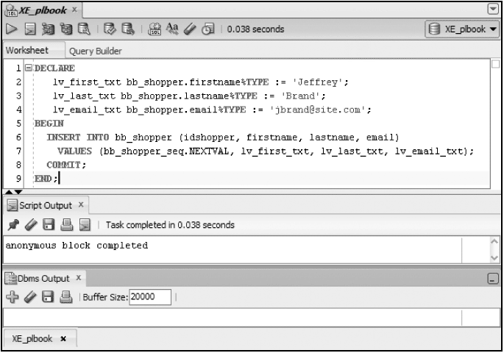
Including DML (continued)
Add a new shopper - INSERT
Oracle11g: PL/SQL Programming

Slide 4
Include SQL within a Block (continued)
SELECT statements work slightly differently.
Outside of CURSORS (we will learn about these later), SELECT statements in the body of a PL/SQL block can only retrieve one row of data.
  If a SELECT retrieves more or less, an automatic exception will occur.
The data retrieved must be put someplace.
CPRG 307

Slide 5
Include SQL within a Block (continued)
An INTO clause is added to a SELECT statement to move data retrieved into variables
  These variables must have already been declared in the declaration area of the PL/SQL block
  SELECT deptno, ename
  INTO v_deptno, v_ename
  FROM emp
  WHERE empno = 10;
CPRG 307

Slide 6
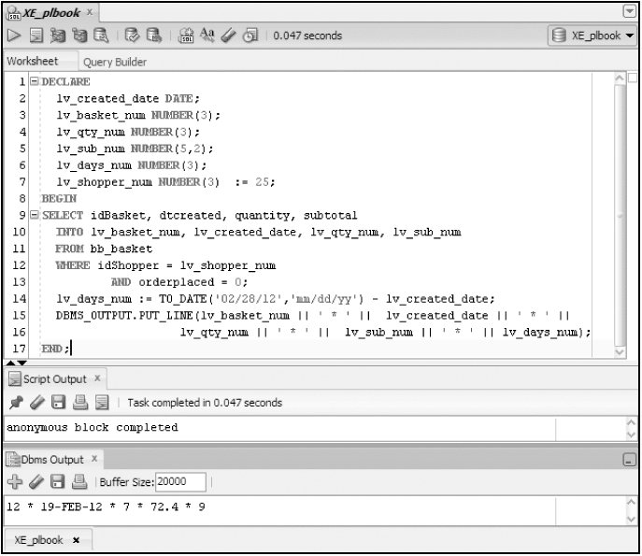
Include SQL within a Block (continued)
SQL
Query – add
INTO clause
Assignment Statement
Oracle11g: PL/SQL Programming

Slide 7
Executing a Block with Errors
Common Errors
  Use = rather than :=
  Not declaring a variable
  Misspelling a variable name
  Not ending a statement with ;
  No data returned from a SELECT statement
  Too many rows returned from a SELECT statement
Oracle11g: PL/SQL Programming

Slide 8
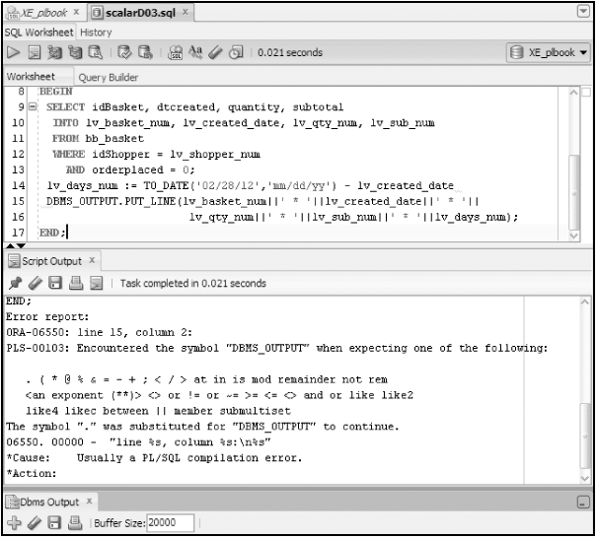
Executing a Block with Errors (continued)
Not closing a statement with ;
Oracle11g: PL/SQL Programming

Slide 9
%TYPE Attribute
Use in variable declaration to provide data type based on a table column
Ideal for declaring variables that will hold data from the database
Minimizes maintenance by avoiding program changes to reflect database column changes
Called an anchored data type
lv_basket_num bb_basket.idBasket%TYPE;
Oracle11g: PL/SQL Programming

Slide 10
Record variables
Stores multiple values of different data types as one unit
Record – can hold one row of data
Oracle11g: PL/SQL Programming

Slide 11
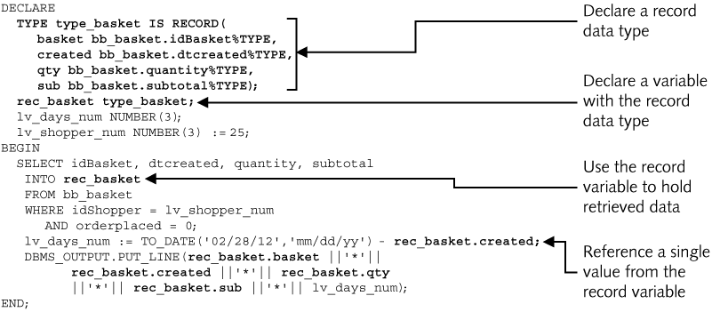
Record Data Type
Oracle11g: PL/SQL Programming

Slide 12
%ROWTYPE Attribute
Create record structure based on table structure
DECLARE
rec_shopper bb_shopper%ROWTYPE;
BEGIN
SELECT *
INTO rec_shopper
FROM bb_shopper
WHERE idshopper = 25;
DBMS_OUTPUT.PUT_LINE(rec_shopper.lastname);
DBMS_OUTPUT.PUT_LINE(rec_shopper.address);
DBMS_OUTPUT.PUT_LINE(rec_shopper.email);
END;
Oracle11g: PL/SQL Programming

Slide 13
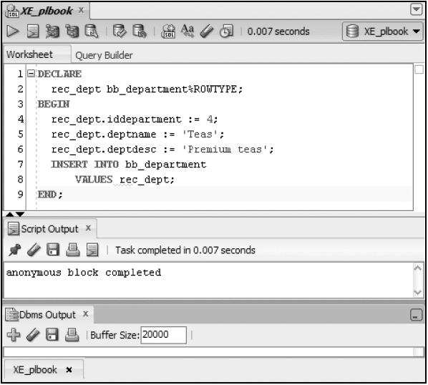
INSERT Using Record
Oracle11g: PL/SQL Programming

Slide 14
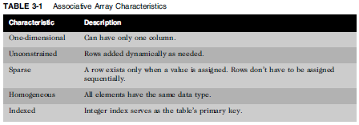
Collections
Store multiple values of the same data type
Similar to arrays in other languages
Associative Array– handle many rows of one field
Oracle11g: PL/SQL Programming

Slide 15
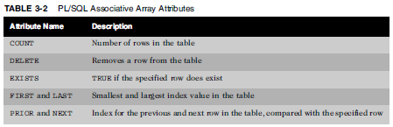
Associative Array Attributes
Oracle11g: PL/SQL Programming

Slide 16
Associative Array Example
DECLARE
-- Create an collection (associative array) type (our own data type)
TYPE type_sale IS TABLE OF NUMBER
INDEX BY BINARY_INTEGER;
-- Create a variable based on the type just created
tbl_sale type_sale;
v_product_count NUMBER;
v_price_difference NUMBER;
v_sale_loss NUMBER := 0;
v_product_type bb_product.type%TYPE;
k_discounted_price_all CONSTANT NUMBER := 0.15;
k_discounted_price_e CONSTANT NUMBER := 0.05;
k_discounted_price_b CONSTANT NUMBER := 0.02;
k_type_e CONSTANT CHAR(1) := 'E';
k_type_b CONSTANT CHAR(1) := 'B';
CPRG 307

Slide 17
Associative Array Example
BEGIN
SELECT COUNT(*)
INTO v_product_count
FROM bb_product;
-- Assumes will be no gaps in product ID
FOR i IN 1..v_product_count LOOP
-- Discounted value for all products
SELECT price * k_discounted_price_all, type
INTO tbl_sale(i), v_product_type
FROM bb_product
WHERE idProduct = i;
-- Extra discount based on the product type
IF (v_product_type = k_type_e) THEN
tbl_sale(i) := tbl_sale(i) * k_discounted_price_e;
ELSIF (v_product_type = k_type_b) THEN
tbl_sale(i) := tbl_sale(i) * k_discounted_price_b;
END IF;
END LOOP;
FOR i IN 1..v_product_count LOOP
v_sale_loss := v_sale_loss + tbl_sale(i);
END LOOP;
DBMS_OUTPUT.PUT_LINE(v_sale_loss);
END;
/
CPRG 307

Slide 18
Table of Records Example
DECLARE
-- Create an table of records (array of records) type (our own data type)
TYPE type_product_sale IS TABLE OF bb_product%ROWTYPE
INDEX BY BINARY_INTEGER;
-- Create a variable based on the type just created
tbl_product_sale type_product_sale;
v_product_count NUMBER;
v_price_difference NUMBER;
v_sale_loss NUMBER := 0;
k_discounted_price_all CONSTANT NUMBER := 0.15;
k_discounted_price_e CONSTANT NUMBER := 0.05;
k_discounted_price_b CONSTANT NUMBER := 0.02;
k_type_e CONSTANT CHAR(1) := 'E';
k_type_b CONSTANT CHAR(1) := 'B';
BEGIN
SELECT COUNT(*)
INTO v_product_count
FROM bb_product;
CPRG 307

Slide 19
Table of Records Example
-- Assumes will be no gaps in product ID
FOR i IN 1..v_product_count LOOP
SELECT *
INTO tbl_product_sale(i)
FROM bb_product
WHERE idProduct = i;
END LOOP;
FOR i IN 1..v_product_count LOOP
-- Discounted value for all products
tbl_product_sale(i).price := tbl_product_sale(i).price * k_discounted_price_all;
-- Extra discount based on the product type
IF (tbl_product_sale(i).type = k_type_e) THEN
tbl_product_sale(i).price := tbl_product_sale(i).price *
k_discounted_price_e;
ELSIF (tbl_product_sale(i).type = k_type_b) THEN
tbl_product_sale(i).price := tbl_product_sale(i).price *
k_discounted_price_b;
END IF;
v_sale_loss := v_sale_loss + tbl_product_sale(i).price;
END LOOP;
DBMS_OUTPUT.PUT_LINE(v_sale_loss);
END;
/
CPRG 307

